Slide 1
Moving Past the Arduino IDE for Embedded Development

Slide 2
Speaker Bio
Al Rodriguez
.NET Dev for over a decade
Java Dev for the beginning of that
@ProgrammerAL on Twitter

Slide 3
Goal
Create an embedded app that can communicate over a radio
Not Wifi
Not Bluetooth
Custom RF signals
Create script to allow repeat:
Builds
Deployments
Unit Tests

Slide 4
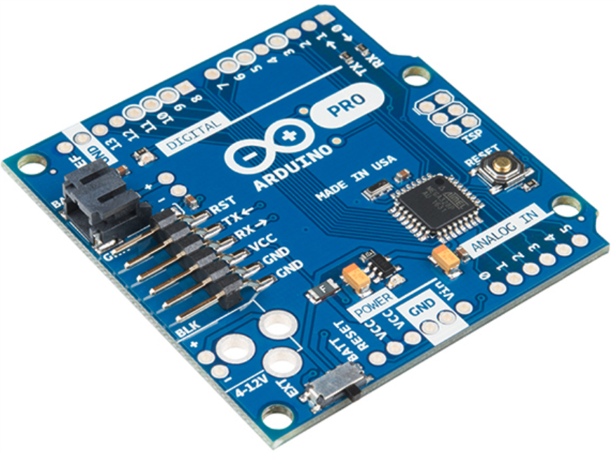
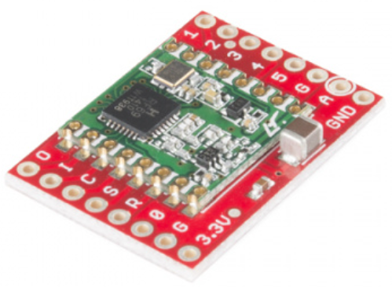
Hardware
Arduino Pro 328 – 3.3V
Sparkfun RFM69 Transceiver (915 MHz)

Slide 5
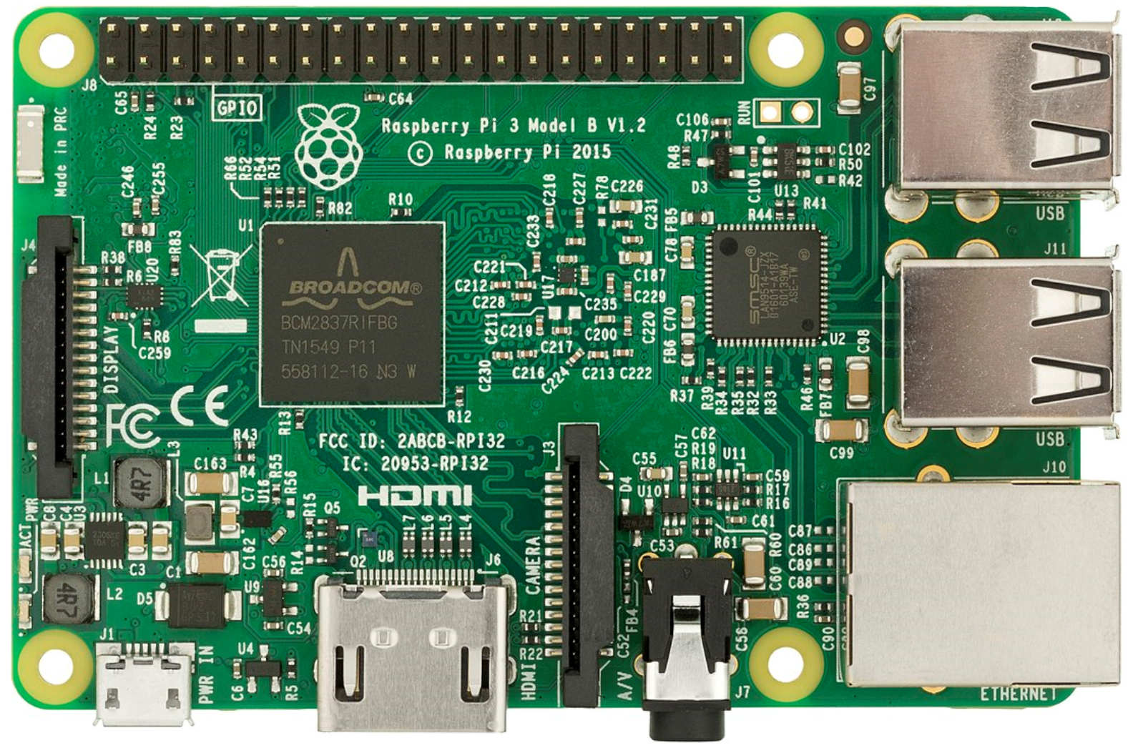
Extra Hardware
Raspberry Pi
Sparkfun RFM69 Transceiver (915 MHz)

Slide 6
RFM69 Transceiver
Sends/Receives Radio Frequency messages
Not WiFi/Bluetooth/etc
Range limited by antenna
Transceivers have an Network (0-255)
Networks have Nodes (0-254)
Also have Broadcast Mode (node 255)
Can perform message Acknowledgement
Can perform message encryption

Slide 7
Steps to Create an Embedded App
1) Type out the code
2) Compile to Native Instructions (8-bit ARM in our case)
With choice of compiler depending on language
3) Copy binary file to target board

Slide 8
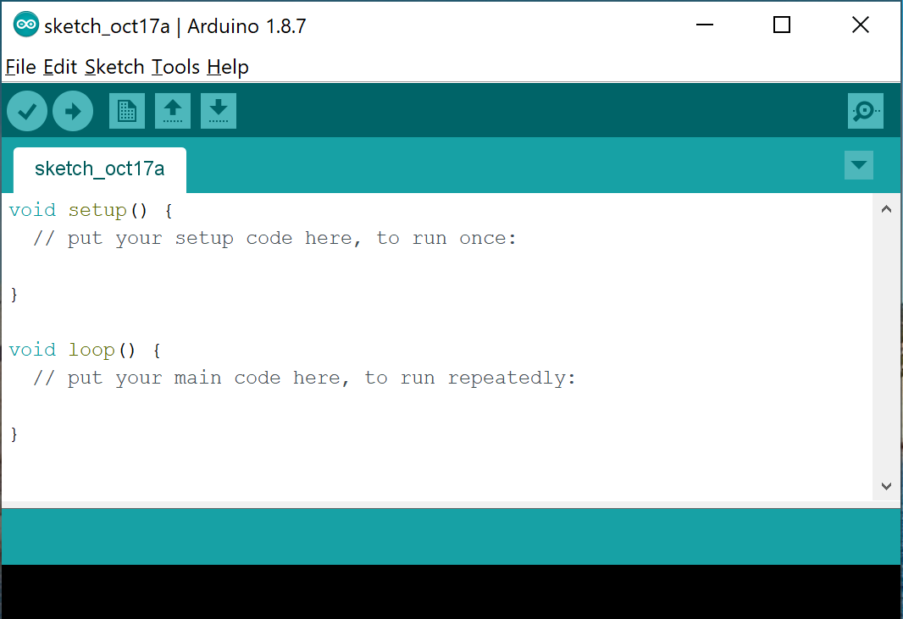
Arduino IDE
https://www.arduino.cc/
Pros
Easy to setup
Abstracts low level concepts
C and C++ under the hood
Adding external libraries is very easy
Cons
Built for prototyping
Proprietary project system

Slide 9
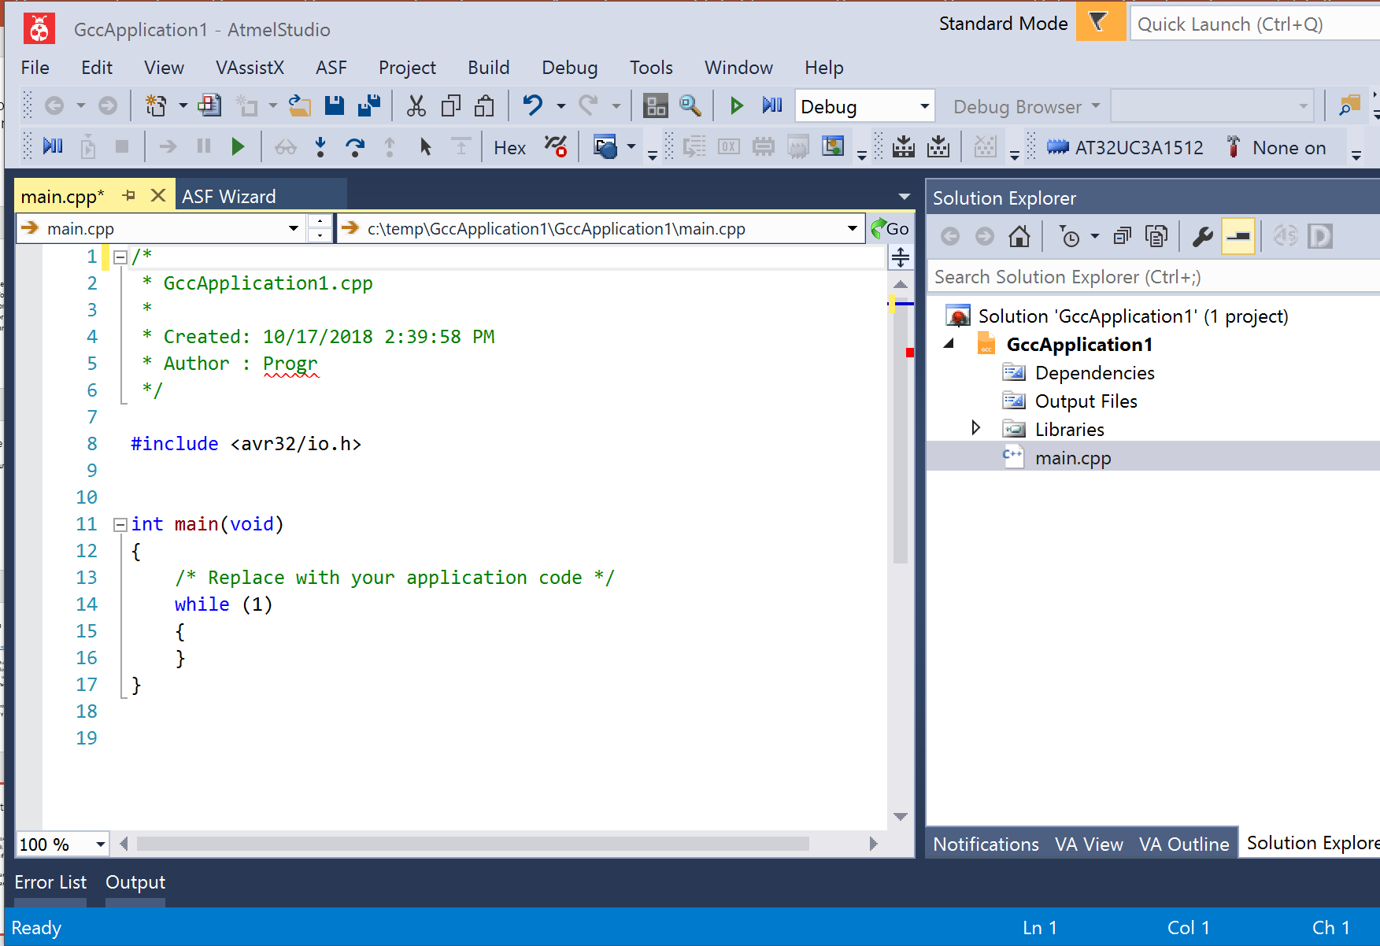
Atmel Studio
Pros
Lots of tools built in
Can work with C, C++, and Arduino projects
Familiar if you use Visual Studio
Cons
Some manual setup
Proprietary project system

Slide 10
Roll Your Own with CMake
Pros
Cross Platform
Cross IDE
Can add unit tests!!!
Cons
Lots of time to setup
Easy to lose cross-platform benefits

Slide 11
What’s Installed on the Machine
Arduino
Just for AVRDude. You may not need this for your projects.
Atmel Studio
AVR Toolchain
C/C++ compilers, linker, etc
AVR Standard Library
Note: Arduino IDE Installs this too
Atmel Studio has newer versions than what Arduino comes with
Visual Studio 2017
Include C++ features
Include Windows 8.1 SDK (for compiling unit tests to x86)
NMake
Installed by Visual Studio
CMake

Slide 12
Embedded C/C++ Gotchas
No stdlib
Missing a lot of features you’re used to
‘new’ keyword
Can make your own or find them online
Trickery involved in getting unit tests created/run
Can’t debug easily
Reminder: This does not include Arduino stuff

Slide 13
CMake Basics
CMakeLists.txt file
Turing complete build script
Runs any other commands you write (like code)
Sets files to be compiled
How to compile them
Which directories to include
Sets language(s) used
Toggle tests
Etc

Slide 14
Cmake Gotchas
Manually add/remove files included in compilation
Can use wildcard to find files, but not recommended
Variable scope/lifetime
CMakeSettings.json
Used by Visual Studio to hold command line options
Not used by other IDEs

Slide 15
Unit Tests
CTest – Enabled in CMakeLists.txt file
Google Test
Follows XUnit pattern of testing
Compiled/Run as x86 app
Run on local machine, not embedded hardware

Slide 16
Google Test with CMake
Many ways to do this
This project always downloads/compiles GTest locally from GitHub
/ThirdParty/GoogleTest folder

Slide 17
What else to look into?
Debuggers
They exist!
No idea how they work…
Other build systems for C/C++
https://medium.com/@julienjorge/an-overview-of-build-systems-mostly-for-c-projects-ac9931494444
Rust Language?
Found a compiler somewhere on the internet to generate AVR. Not officially supported.

Slide 18
Other Systems
Arduino CLI
https://github.com/arduino/arduino-cli
Arduino IDE, but a CLI tool
Meant for scripting scenarios
IoTZ
https://github.com/Azure/iotz
Wrapper to other tools for working with embedded applications
One Stop Shop for embedded tooling
NPM Package

Slide 19
Other Resources
ATMEL AVR Microcontrollers book
Starts out with a great description embedded development in general
https://www.amazon.com/Programming-Interfacing-ATMELs-Thomas-Grace/dp/1305509994

